Slide 1
Good and Bad Design
HCI Presentation
Name: Aljieo Tolibas
Section: IT2A

Slide 2
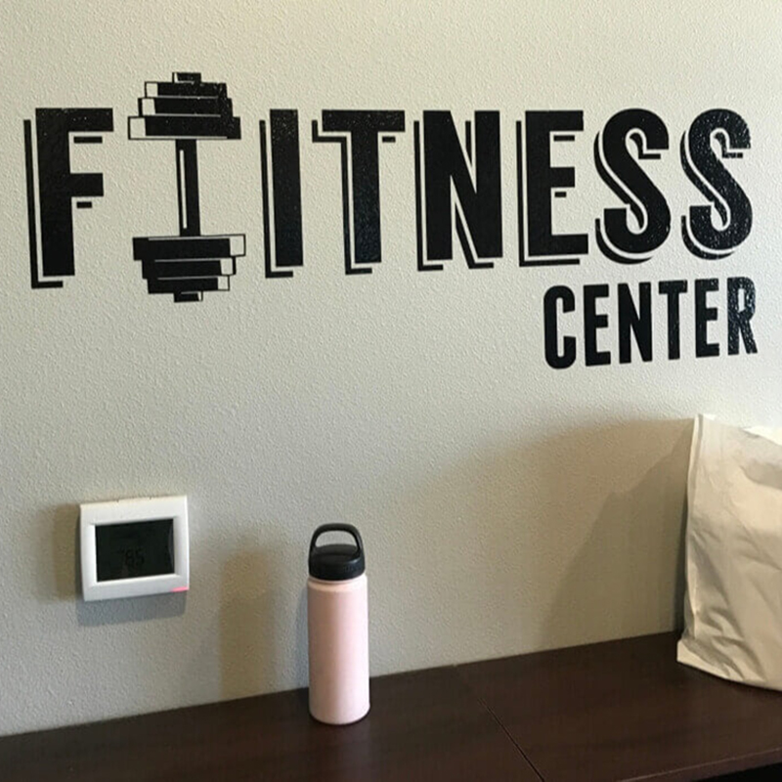
Bad Good

Slide 3
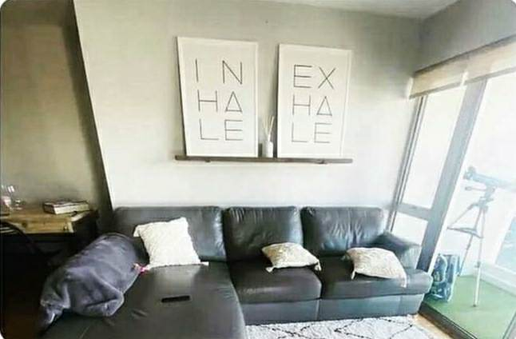

Bad Good

Slide 4


Bad Good

Slide 5
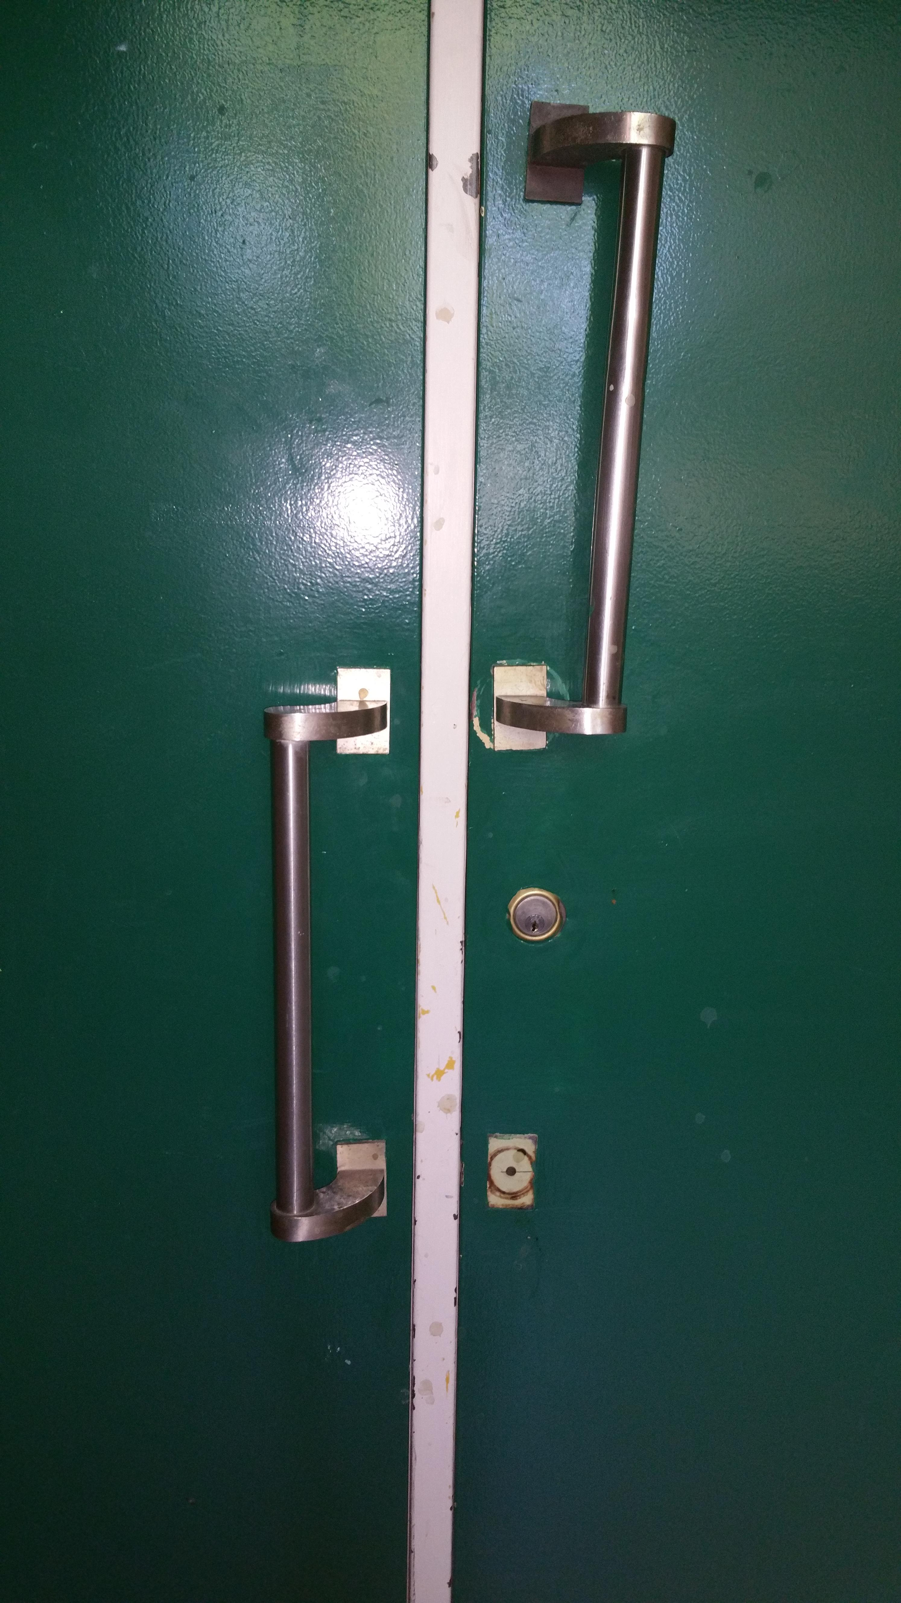
Bad Good

Slide 6
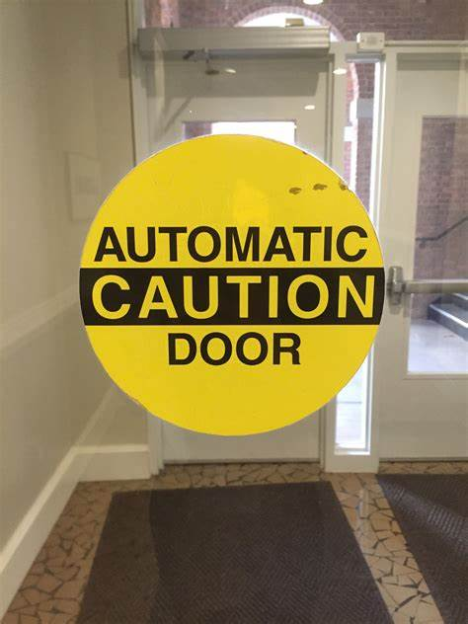
Bad Good
CAUTION
AUTOMATIC DOOR

Slide 7
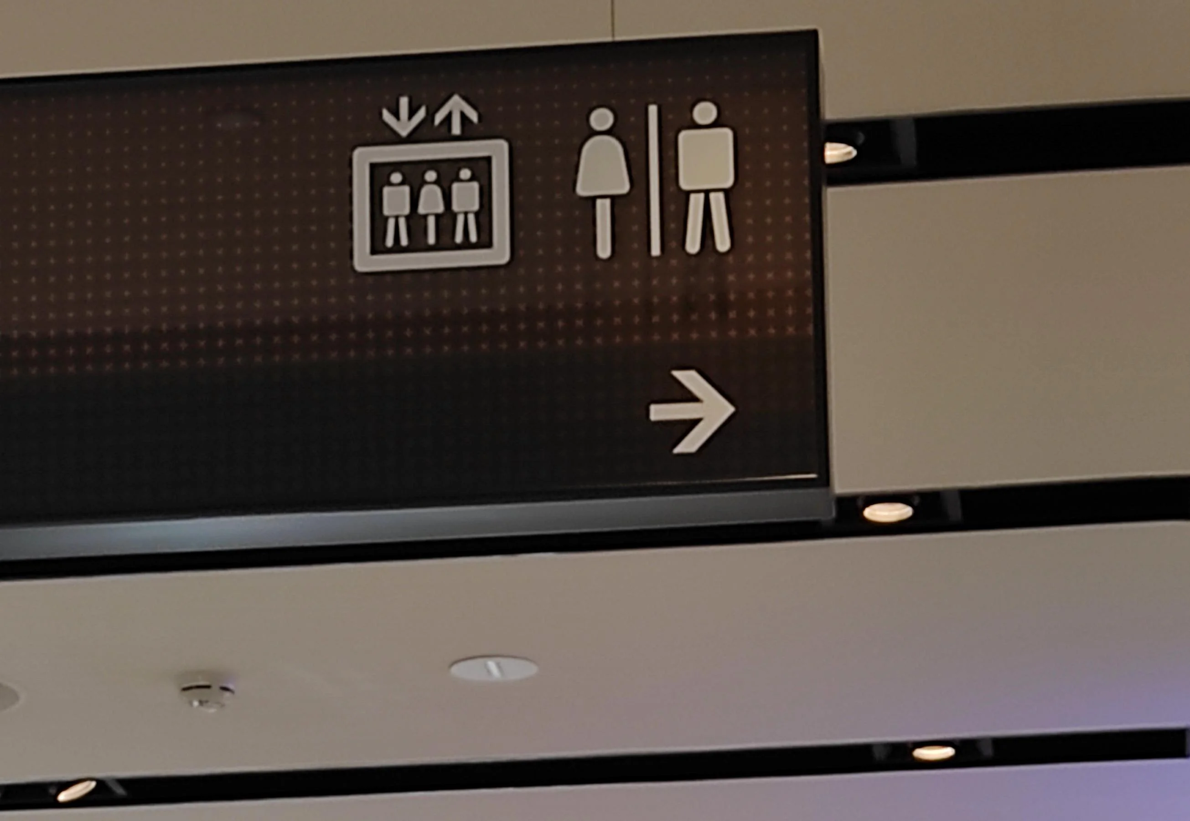
Bad Good

Slide 8
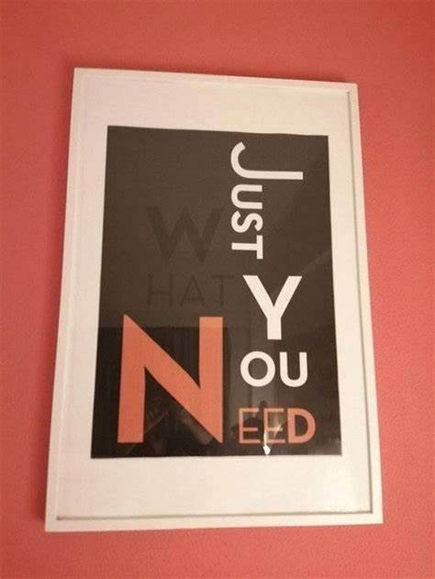
Bad Good
JUST
N
WHAT
E
YOU
E
D

Slide 9
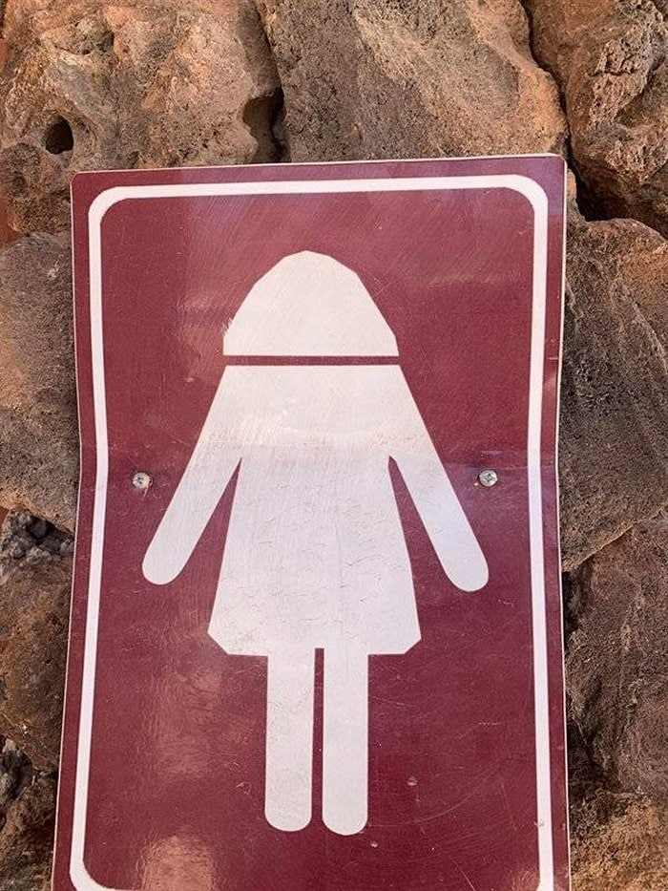
Bad Good

Slide 10
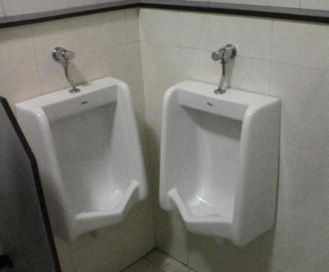
Bad Good

Slide 11
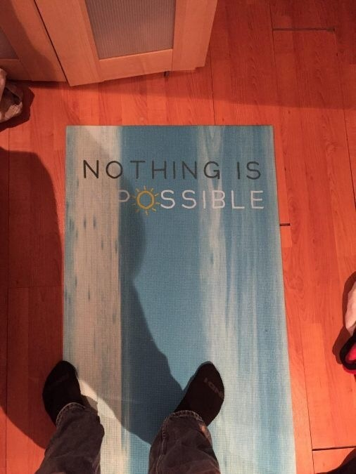
Bad Good

Slide 12
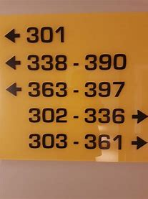
Bad Good

Slide 13
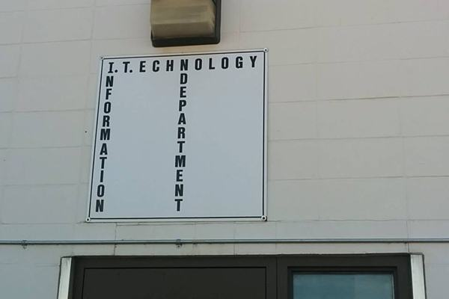
Bad Good
I N F O R M A T I O N
T E C H N O L O G Y
D E P A R T M E N T
I.T.D

Slide 14
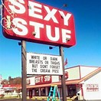
Bad Good
SEXY
STUFF

Slide 15

Bad Good

Slide 16

Bad Good
S A F E P L A C E

Slide 17
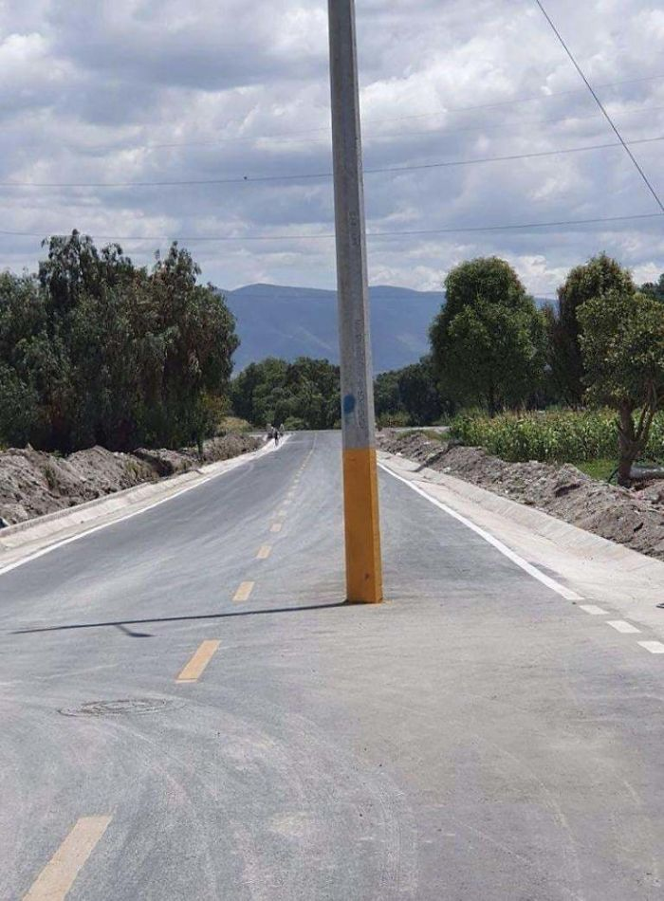
Bad Good

Slide 18
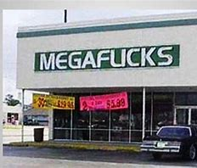
Bad Good
MEGAFLICKS

Slide 19
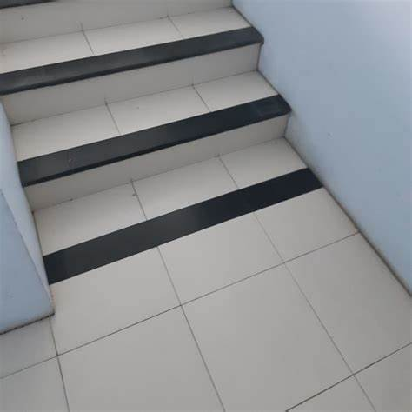
Bad Good

Slide 20

Bad Good

Slide 21
Bad Good
NO DOORKNOB
WITH DOORKNOB

